Slide 1

Minimaps
Marc Pagès Francesch

Slide 2
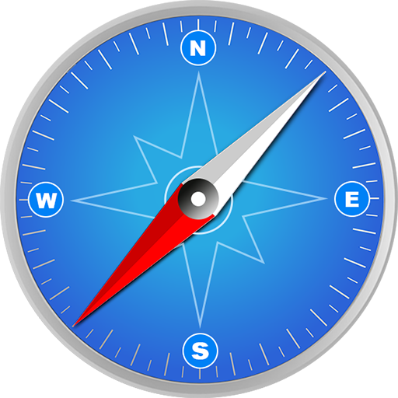
What’s a minimap?
Miniature representation
Guide the player through the world
Show the position of important elements
Notes:
A minimap is a small representation of the map located in a part of the screen which may help the player get oriented in the game world.
It might show the position of important elements of the world, allies or enemies using icons or show the path to an objective.

Slide 3
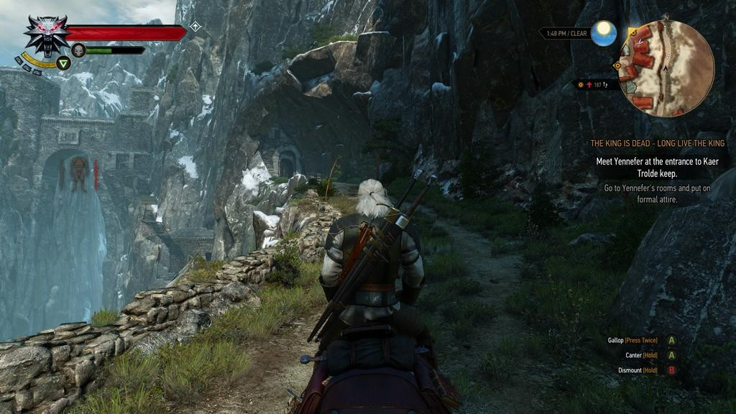
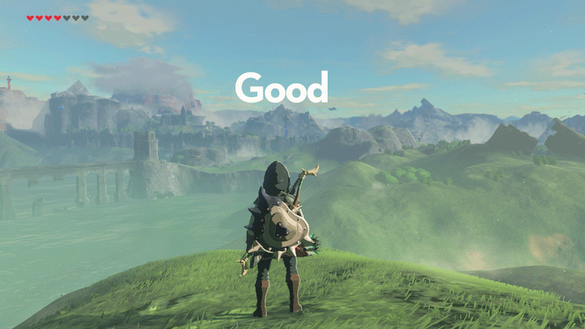
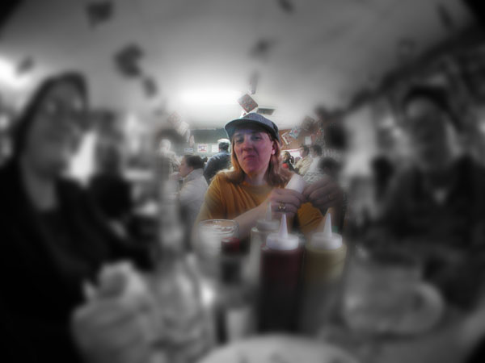
The use of the minimap
Position
Inmersion
The Legend of Zelda: Breath of the Wild
Notes:
The minimap has created controversy between game devs and players for various reasons, the main ones are:
Inmersion: The minimap along with other UI elements can break the player’s immersion into the game because of not being part of the game world. Some say that the screen should remain as clean as possible displaying the lesser elements possible.
Position: In addition to the reason mentioned the UI is normally bad positioned. If we take a look at how human vision works we will see that in the middle of our vision field the images are nitid are coloured and around it the images are diffuse and colorless. We may not perceive it because the brain interprets the few information that receives from the peripheral vision and lets us make a general image which seems quite nitid and colored. For this reason when playing a video game the most important information should remain in the middle of the screen and the less important information on the sides. If we use a minimap and we need information from it we won’t get that information from the peripheral vision, we will have to focus on the minimap, centering our vision on it, distracting us from the game, a situation we shouldn’t create.

Slide 4
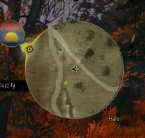
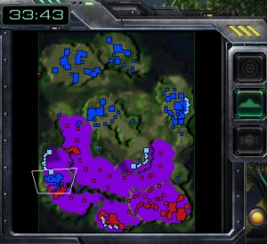
Characteristics of a minimap
The Witcher 3: Wild Hunt
Starcraft 2
Notes:
Minimaps normally have a series of characteristics which can variate depending on the game but that we can set as generals.
It should mark north to let the player get oriented in space.
The map can either be fixed to north or to the player. Depending on it the minimap will rotate or not.
It can be isometric or orthogonal.
It must show important elements represented by icons.
If necessary it can show the position of allies or enemies.
Minimap icons shouldn’t be too big in relation to the minimap in order to see them clearly and not opaque the minimap.
If the game is for PC and the player needs to jump from one point of the map to the other the map should be interactable.
To help people with colorblindness the icons colors should be modifiable.
Depending on the genre it can represent all the map or just a zoomed part of it.

Slide 5
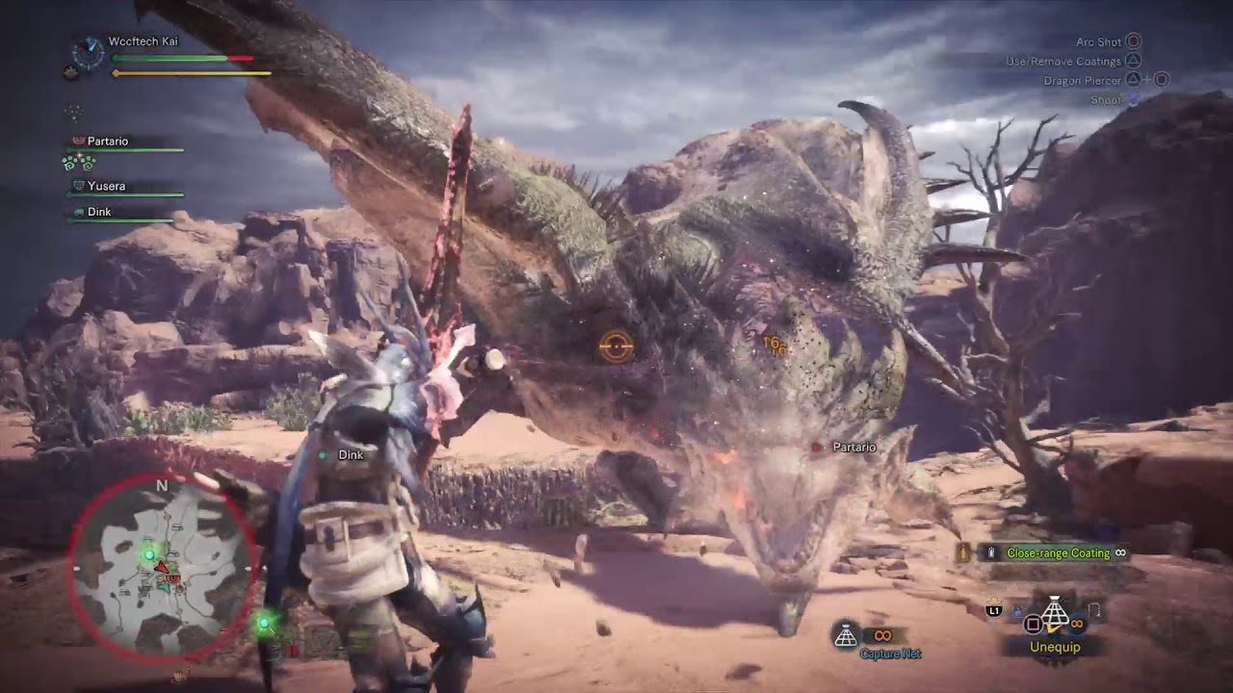
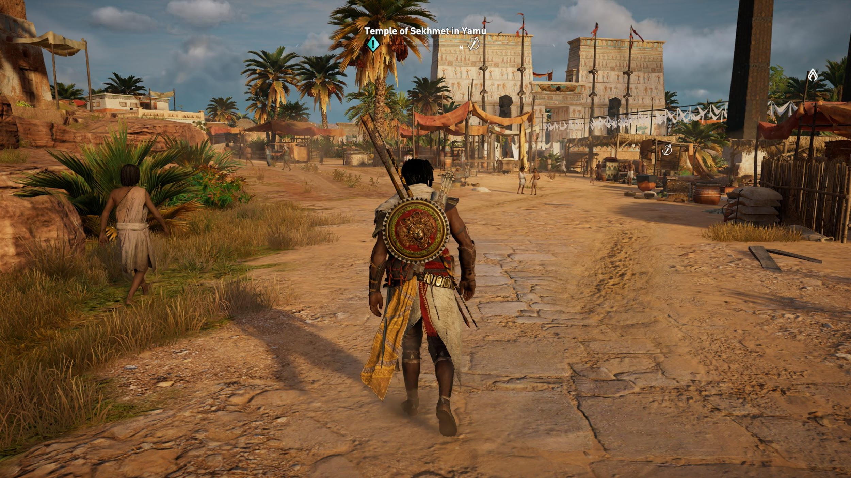
The future of minimaps
Monster Hunter World
Assassin’s Creed Origins
Notes:
For the reasons explained two slides ago some companies have started removing the minimaps from their franchises. Some have decided to just not include any UI elements to replace it while others have replaced it by another UI element which has been between us for a long time: the compass. This element is composed by a bar which shows which elements are in the direction the player is looking at simplifying the positions into directions and making the UI way cleaner. This element still breaks a little bit the immersion of the player but not as much as the minimap and it doesn’t occupy as much space. The future is still uncertain about what will happen to minimaps because some companies don’t seem to want to renounce to them in a near future but it is possible that this UI element ends up disappearing.

Slide 6
Implementation in code

Slide 7





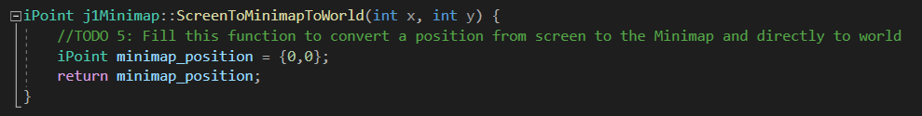
Code structure
Minimap
Player
Start
PostUpdate
PreUpdate

Slide 8
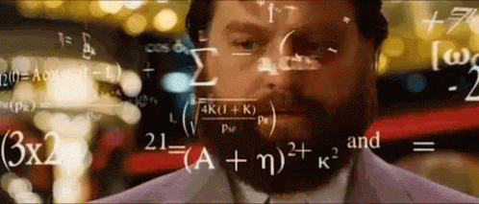
TODO 1: Calculate the dimensions of the minimap
You should determine the scale calculating the map size and relating it to the target map width given in config.

Slide 9
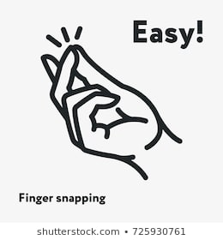
TODO 2: Create a texture for the minimap
Create a texture not only a pointer to it.
Check SDL_CreateTexture for further details

Slide 10
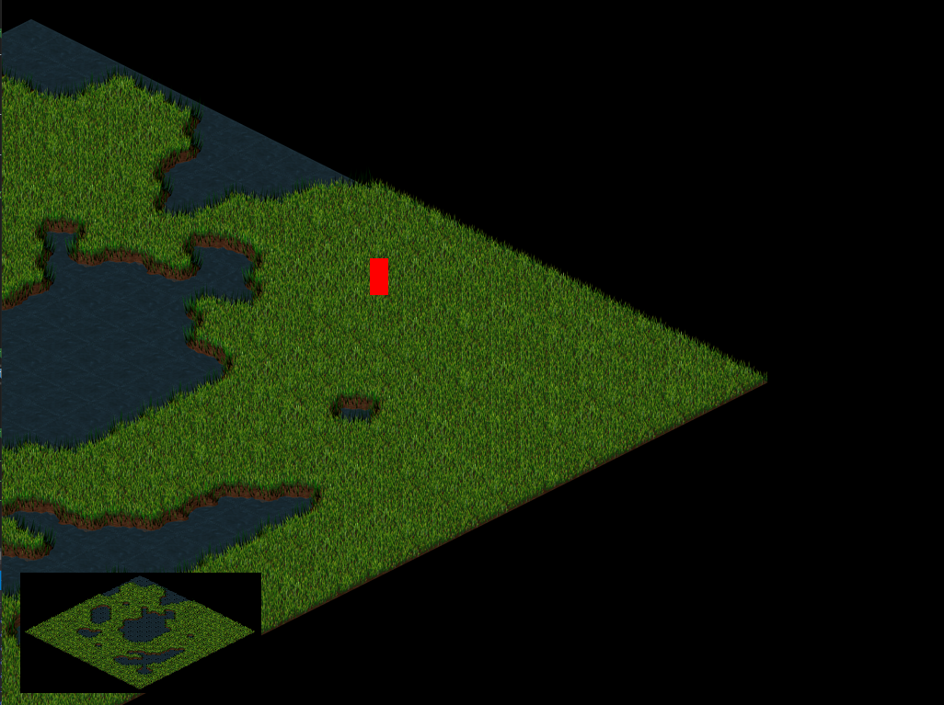
TODO 3: Set this texture as a rendering target and create the minimap
Check SDL_SetRenderTarget for further information on how to save the information from the render into a texture.
Don’t forget to untarget the texture when you have finished drawing the map!

Slide 11
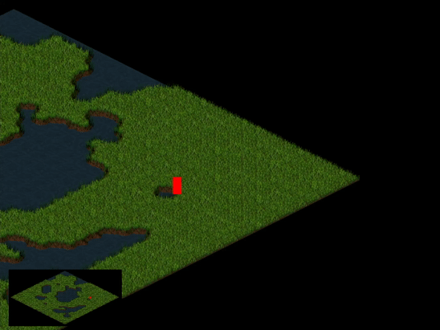
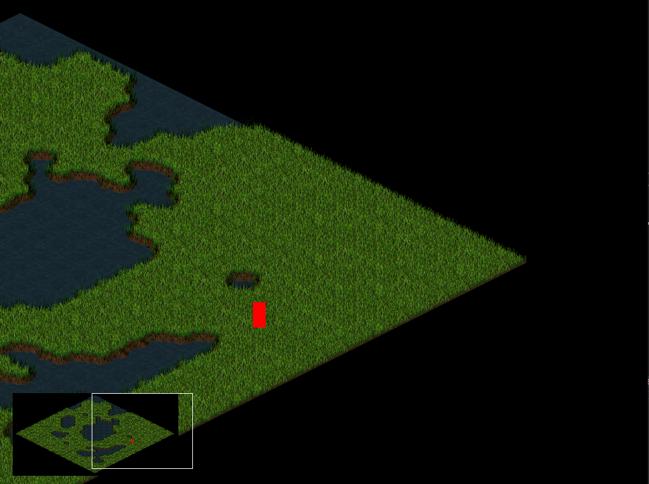
TODO 4.1: Fill the function WorldToMinimap to make the representation of the rect in the minimap be in the position it should
TODO 4.2: Using WorldToMinimap create a white rect which represents the area that the camera records of the world onto the minimap

Slide 12


TODO 5: Convert a position from the screen to the Minimap and directly to world
Fill the function which can convert a screen position into world coordinates knowing the minimap position and the scale.

Slide 13
TODO 6: Transform the position of the mouse into Minimap coordinates and then to the world
You should use the function made in the last TODO

Slide 14
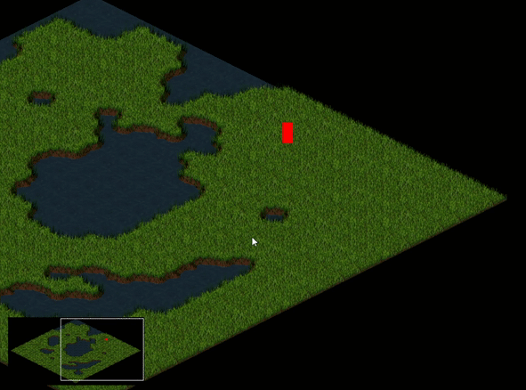
TODO 7: Move the camera when the player clicks on the minimap or scrolls the mouse on it while holding the left button
It should only detect the mouse when it is over the minimap.
Be aware of the final sign of the camera position!

Slide 15

Homework
Add more icons onto the minimap.
Try replacing the squares by textures.
Using the config file try changing the corner in which the minimap, the margin and the width.
Try replacing the black background by a colored one.

Slide 16

Thank you for your attention!

